Slide 1
Efficient Integrated Reliability and Maintainability Process Development and Implementation within the DE Environment as Part of the Army Transformation Initiative
John Bieda¹, Jason Gargrave¹, Michael Damiani¹,
Kasey Marlowe², Sean McGuinness², (¹US Army
DEVCOM GVSC, ²Deloitte)
DISTRIBUTION STATEMENT A.
Approved for public release; distribution is unlimited. OPSEC # 2026-370

Slide 2
Introductory Remarks

Slide 3
Primary Objective
To provide an efficiently structured and integrated R&M process that would significantly facilitate the successful implementation of key R&M tasks within a Digital Engineering (DE) environment during the product design development process as part of the Army Transformation Initiative. These tasks should be developed to link key output deliverables to influence execution and help address the relationship between a system’s design risk and its R&M model demonstration.

Slide 4
Key Process Elements - Efficiencies
Establish a comprehensive, integrated, and systemic design for reliability and maintainability process during the design phase in a DE operating environment.
Define the direct relationship between design risk and reliability.
Strategically focus on the design mitigation efforts of high-risk failure modes/mechanisms.
Leverage Power BI dashboards to summarize findings and facilitate R&M decision-making.

Slide 5
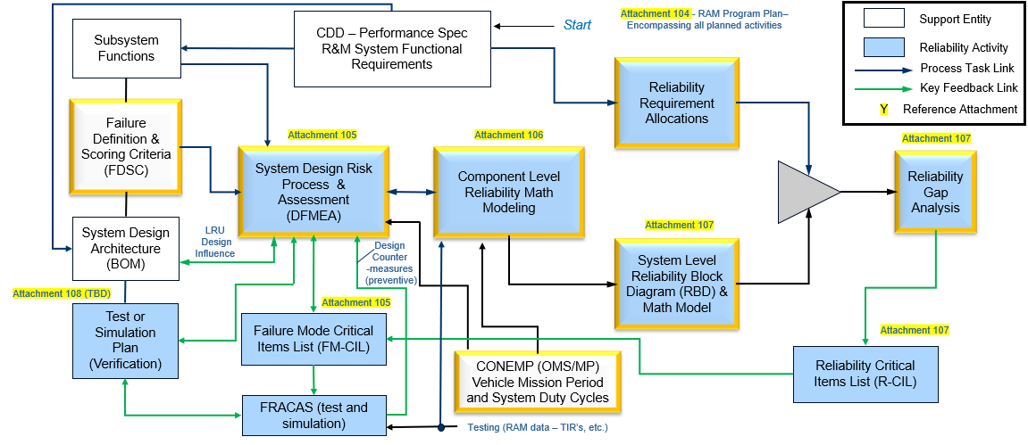
Integrated Design for Reliability (DFR) Tasks Mapping
Inter-relationships across principal reliability tasks necessary for proper definition of projected system reliability and its contributing risks

Slide 6
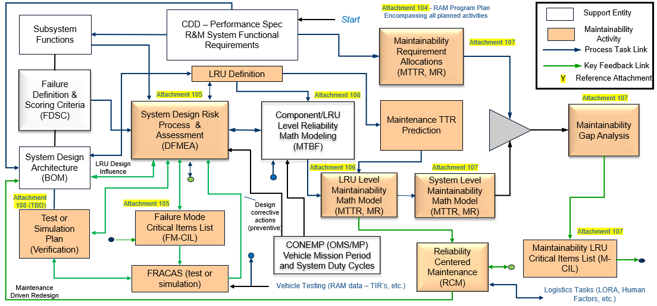
Integrated Design for Maintainability (DFM) Tasks Mapping
Inter-relationships across principal maintainability tasks necessary for proper definition of projected system maintainability and its contributing risks

Slide 7
Integrated R&M Development Tasks - Design Risk Assessment (DFMEA) Detailed Process (key centerpiece)

Slide 8
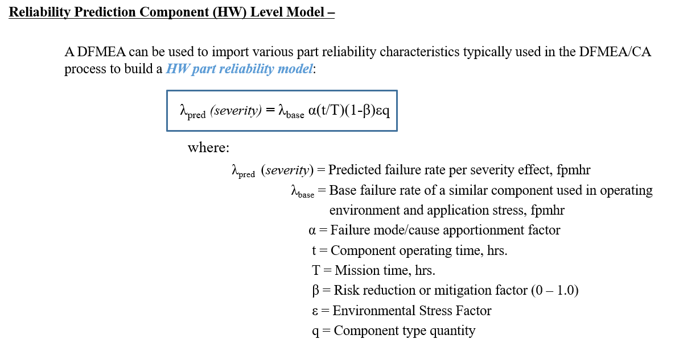
Integrated Design for Reliability Tasks – Reliability Component/LRU Level Hardware Prediction Modeling
Component level failure rate math model encompasses all key influential parameters that affect component failure rate behavior

Slide 9
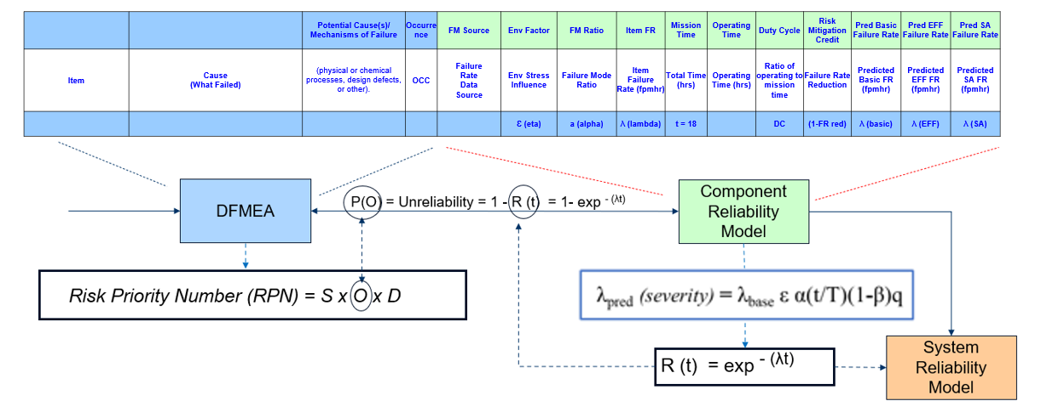
Integrated Design for Reliability (DFR) Tasks –
DFMEA to Component Reliability Modeling
Intra-relationship - DFMEA and HW/SW level reliability prediction model can be linked to provide immediate impact of DFMEA design risk reduction activity to the component level reliability model

Slide 10
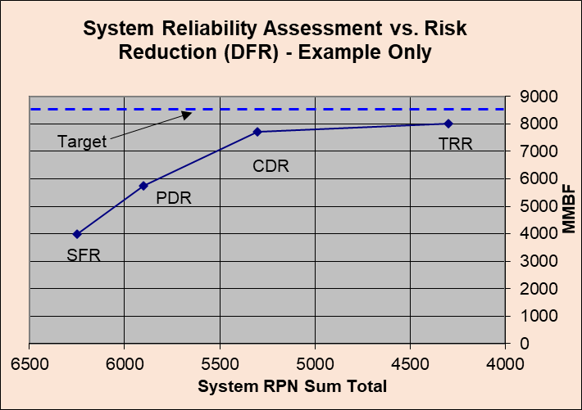
Integrated Design for Reliability Tasks –
DFMEA to Reliability Model Output Profile
A direct relationship can be established between the current design risk assessment results (DFMEA) to the projected reliability. This profile is used to help track and monitor how a system’s design risk changes (as a function of corrective action - design modification) and its direct impact to projected system reliability during each phase of the product’s design development cycle. The goal is to observe a sufficient reduction in total design risk and a resulting increase in projected design reliability as the system design matures.

Slide 11
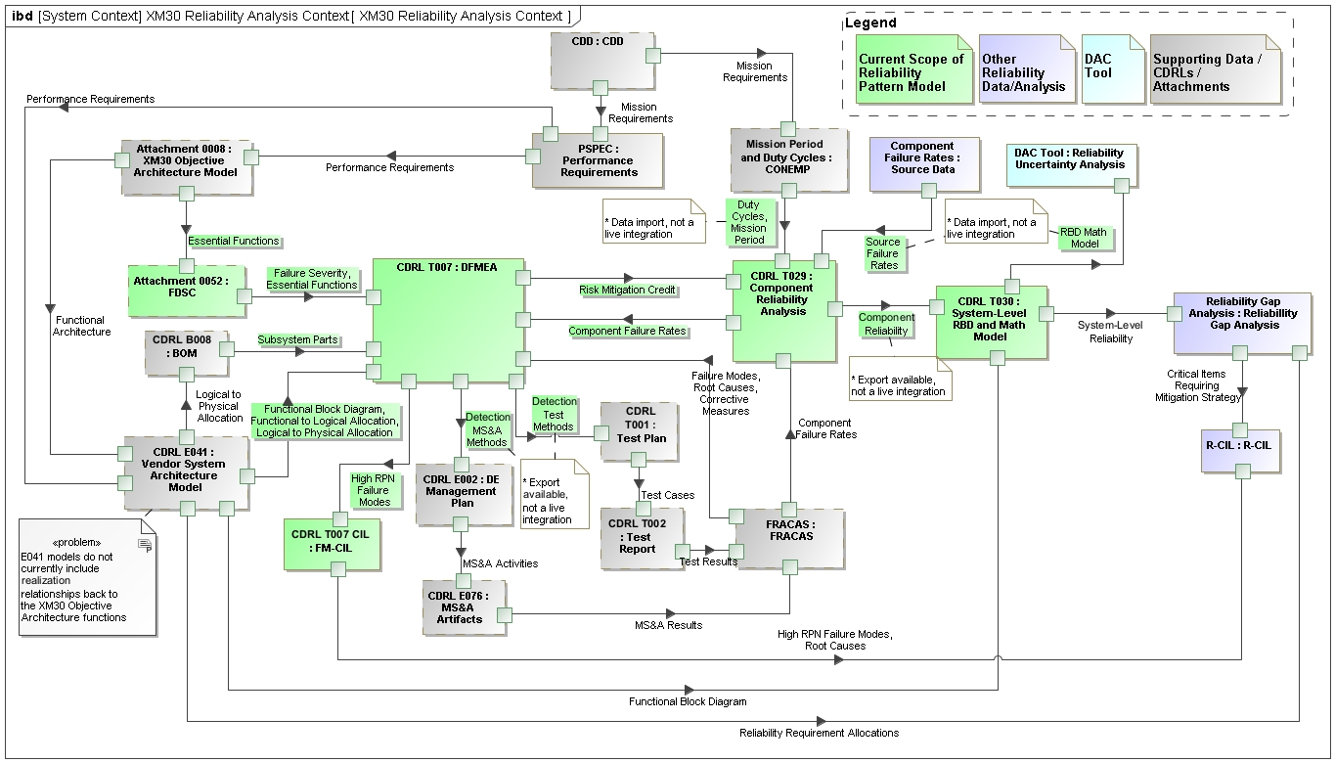
Integrated Design for Reliability Task Modeling in the DE Environment

Slide 12
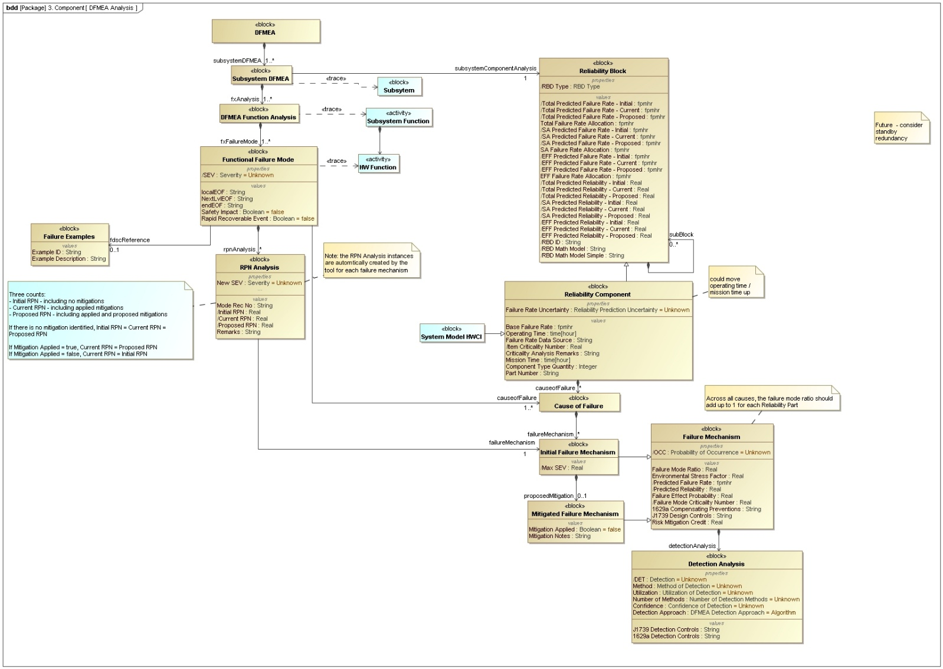
Integrated Design for Reliability Tasks –
DFMEA Modeling in the DE Environment
The DFMEA Model focuses on functional analysis and assessing the Risk Priority Number (RPN) of each potential failure. This model includes:
  Subsystem functions to be analyzed
  Functional failure modes for each function
    Effects of the failure
    Severity rating (e.g. SA, EFF, NEFF)
    Linked FDSC example (used to calculate Severity)
  RPN Analysis elements calculate the RPN for each unique functional failure mode and failure mechanism (from component model) that could cause the failure
    Component model elements establish Occurrence rating (based on failure rate) and Detection rating (based on detection analysis algorithm)
RPN = Severity * Occurrence * Detection
  Each input is rated 1-5 (1 = minimal risk, 5 = max risk)
  Max RPN = 5*5*5 = 125

Slide 13
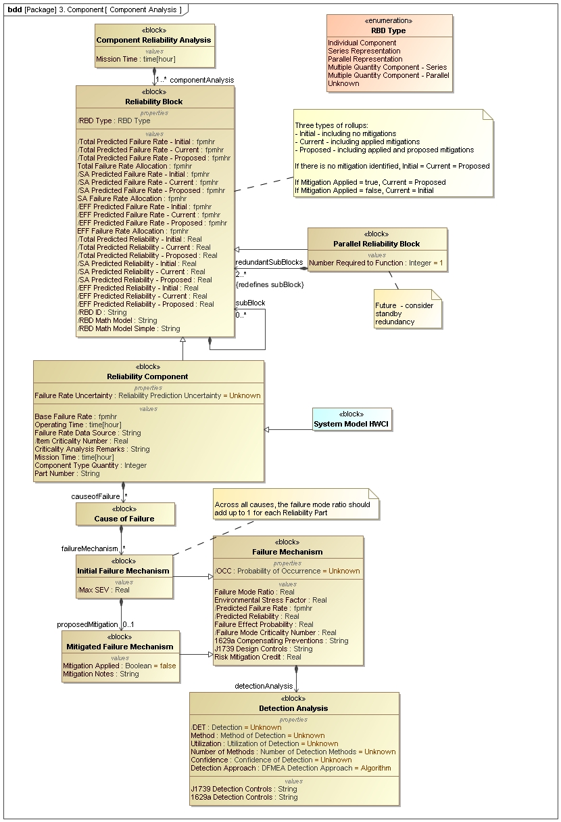
Integrated Design for Reliability Tasks –
DFMEA and Component Reliability Modeling in the DE Environment
The Reliability Component Model focus on physical component analysis to feed into the DFMEA process. This model includes:
  Reliability Analysis for each individual component
    Causes of failure
    Failure mechanisms & proposed mitigations
      Design controls
      Detection controls
    Calculated metrics by severity (total, SA, and EFF)
      Failure rate
      Reliability
    Allocated reliability targets
  Mission parameters
    Mission time
    Operating time by part

Slide 14
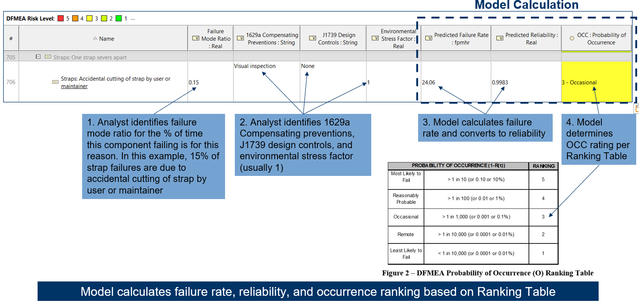
Integrated Design for Reliability Tasks –
DFMEA to Component Reliability Modeling Integration in the DE Environment

Slide 15
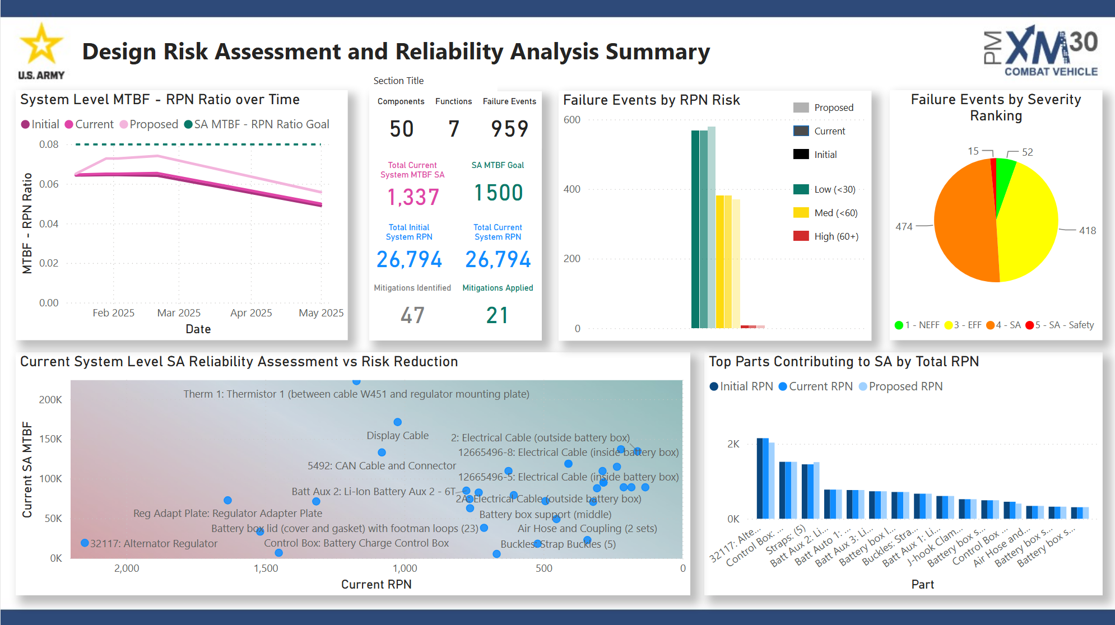
Integrated Design for Reliability Tasks – DFMEA Summary
(example with notional data, not XM30 data)
Utilization of Power BI dashboards to facilitate a summary of the DFR results - current design risk and associated reliability

Slide 16
Integrated R&M Development Tasks – Overall Summary
Key Efficiency Benefits
Developed a comprehensive, integrated, and systemic design for reliability and maintainability process during the design phase.
Defined the direct relationship between design risk and reliability.
Developed approach to efficiently execute integrated risk assessment and reliability modeling within a DE and AI supported environment.
Provided ability to strategically focus effort on the mitigation of high-risk failure modes/mechanisms.
Leveraged Power BI dashboards to summarize findings and facilitate R&M decision-making.

